Slide 1
Christian Citizenship in a Digital World
Lesson 1: Online Privacy

Slide 2
Overview
Lesson 1: Online Privacy
Lesson 2: Personal Identity –
Your brand and reputation.
Lesson 3: Digital Communication
Lesson 4: Digital Etiquette

Slide 3
Lesson 1: Online Privacy

Slide 4
Lesson Objectives
I can list ways information can be gathered about me and how the choices I make can control my personal information.
I can identify the difference between public and private information and what is safe to share with everybody.

Slide 5
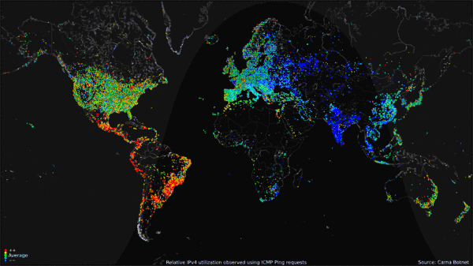
What does this show?
Notes:
----- Meeting Notes (14-01-05 12:01) -----
Read the question to the students. Have them brainstorm answers.

Slide 6
The picture below is a global internet traffic map for an average day in October 2012. It illustrates how we live in a world where information flows from person to person, organization to organization, machine to machine, 24/7.
Notes:
----- Meeting Notes (14-01-05 12:05) -----
Point out that the Northern hemisphere has a majority of the traffic.

Slide 7
Think-Pair-Share How do you contribute to the vast global flow of internet traffic?
Did you think of these?
Facebook
YouTube
Instagram
Gaming
Email
Texts
Notes:
----- Meeting Notes (14-01-05 12:05) -----
Have them discuss the question in pairs and then take some answers.

Slide 8
14 hours and your Digital Trail
Think about an average day in your life. List all the ways you have provided information in one way or another about yourself.
Discuss and share with a partner
Notes:
----- Meeting Notes (14-01-05 12:05) -----
Have the students write down on a blank sheet of paper how they may/could provide information on themselves electronically.

Slide 9
A Day in one Teen’s Life – Your Digital Trail
7:30 Text a friend – even if you delete the text, it still leaves a digital “print” (and also remains on your friend’s device if they don’t delete it) and could still be accessible and tracked down.
8:15 Download an app to your mobile device – online technologies take note of information like your e-mail address, credit card information and what kind of apps you like. Apps can collect all sorts of information about you, including your location and contacts in your address book.
8:42 Late for soccer game – call coach to let team know. Cellular phone calls can easily be intercepted; mobile phone technology signals your whereabouts to satellites to deliver calls.
9:11 Play a shift in game – people could be recording videos and taking pictures of your game with their mobile phones. They could post these on their favourite social networking sites, tagging your name.
10:37 Send personal e-mail to mom at work – this can be read by mom’s employer; simple deletion does not erase it from the computer’s hard drive or the company’s network.
Notes:
----- Meeting Notes (14-01-05 12:06) -----
Quickly read through the next 5 slides. Take questions.

Slide 10
A Day in one Teens Life – Your Digital Trail
10:40 Went to a coffee shop – your geo-location device plots your route and records your vehicle location at all times.
10:43 “Check in” in at coffee shop – you do this on your favourite social networking site, so all your friends know where you are. Anyone with access to your profile can see where you are (and where you aren’t) and, later, you receive personalized marketing recommendations that are based on that particular location.
10:47 Use bank machine at coffee shop – system records details of transaction, cameras overhead or in machine record your behavior.
10:55 Log onto Internet from computer at coffee shop – Your choice of chat groups and your messages can be monitored and a profile assembled by anyone, including police; some web sites keep track of your visits. Coffee shop could also be monitoring your traffic.

Slide 11
A Day in one Teen’s Life – Your Digital Trail
11:00 Post pictures from the party last night on your favourite social networking site – pictures and comments you post can be accessed long into the future, possibly by future college and job interviewers. If the geo-tagging features are enabled on your device, your photo will be tagged with your location. Anyone who can see your photo – and anyone they share the photo with – will know your location. If they know that location is your house, they will know where you live.
11:30 Return some jeans you bought yesterday – for the return you are required to give your driver’s license for the clerk to scan and to fill out a form that asks for your phone number and home address.
11:53 Buy a birthday gift for a friend – credit card records details of purchase, retailer’s loyalty card profiles purchase for points and directed discounts; banks may use spending patterns to help assemble complete customer profile.

Slide 12
A Day in one Teen’s Life – Your Digital Trail
1:00 Buy a fast-food meal – security cameras record your arrival, your debit card purchase is recorded, loyalty card tracks selections for marketing and targeted discounts
2:12 Realize you forgot your mobile phone at fast-food place – if your device isn’t password-protected anybody could pick it up and gain access to any and all personal information on it. If they choose to text or e-mail from it, they could even pretend to be you.
2:32 Return to fast-food place – security cameras record your return.
4:30 Listen to phone messages – your phone has recorded callers’ phone numbers and displays your number when you call others, unless you enter the code to block the display.
5:13 Accept someone you don’t know that well as a “friend” online – if you haven’t set up different privacy settings for different lists of friends, you may be giving that person access to a treasure trove of your personal information.

Slide 13
A Day in one Teen’s Life – Your Digital Trail
7:30 Play a videogame online with some virtual people you have never met – many types of personal information can be collected through online gaming: everything from names, addresses and credit card information for billing purposes, to email addresses and IP addresses, down to feedback rankings from others, digital images and personalized profiles.
9:05 Order some clothing and books online – company records personal details and credit card number and may sell the information to database-list-makers. Next time you visit that company’s web site you may see ads tailored directly to your interests, based on what you purchased at this visit.

Slide 14
What kinds of information are people sharing? What should be private and what should be public?

Slide 15
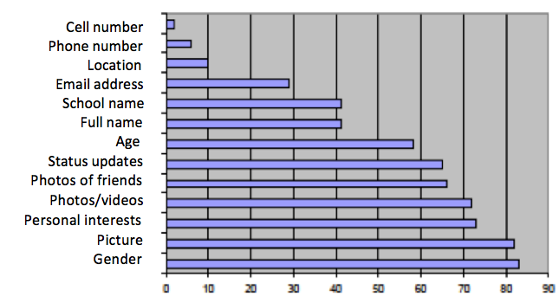
2010 Survey of Teens- What are they Sharing?
Notes:
Have students look at the information. Are they concerned by any of the statistics?

Slide 16
When determining if it is private or public I should consider:
Who is requesting the information? (friend, parent/relative, employer, government, merchant, stranger)
Am I comfortable in releasing this information in a room full of people that I do not know, or a room full of people that I do know?
Are there security guarantees and protection of privacy notices?

Slide 17
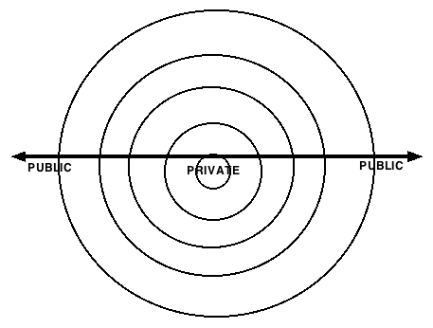
Private or Public?
Notes:
----- Meeting Notes (14-01-05 12:22) -----
Have students determine where the following bits of information would go and why? Have them consider who is requesting the information.
Ex: Merchant – do they need your school name, picture, grades, etc? An employer might need more access to some private information that a merchant does not require.

Slide 18
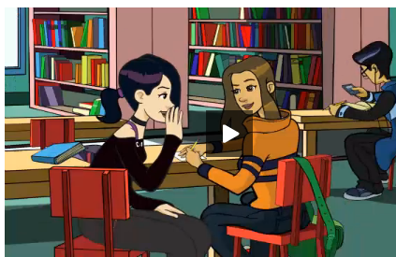
Controlling personal information
Click
http://www.netsmartz.org/NSTeens/PostToBePrivate

Slide 19
Controlling personal information
Click
http://www.netsmartz.org/reallifestories/yourphotofate

Slide 20
Think about your Digital Footprint

Slide 21
Things to consider to protect your privacy and personal information
Learn about the privacy controls on your favourite websites and use them. Sites like Yahoo! and Facebook let you control the information you share with your friends, connections and the world.
Know your connections. As much as possible, only let people you know in real life connect with you online. When people try to add you as a connection, if you don’t really know them, block them so they can’t contact you again.
Protect your personal information. Posting personal information or photos can identify you to strangers and put your safety at risk. Never reveal your full name, address, phone number, school, email address or other personal information to people unless you’re friends in real life or the information is required by government, employer, etc..
Notes:
----- Meeting Notes (14-01-06 14:28) -----
Review Privacy suggestions with students

Slide 22
Protecting your privacy and personal information
Think before you post. Once you put something online, it’s impossible to take it back. Images, text and videos can be copied and reposted over and over without you knowing. So even if just your friends can see what you post, that content could end up anywhere on the Web, which makes it hard and virtually impossible to remove.
Watch out for your friends. You play a part in creating your friends' digital reputations too. Whenever you post videos, tag people in photos or comment on their profiles, you risk revealing private information about your friends. Before you share it, stop and remember that what you post is permanent.
Keep an eye on your digital reputation. Search for your name once a month to see what comes up. If you find information that isn’t true or that shouldn’t be public, work with the person who posted it or the hosting website to take it down.
Notes:
----- Meeting Notes (14-01-06 14:28) -----
Review Privacy suggestions with students

